Slide 1


Honours in Cyber Security & Forensics Applied Cryptography
Ms. Swati Mali
B-215
swatimali@gmail.com
Assistant Professor, Department of Computer Engineering
K. J. Somaiya College of Engineering
Somaiya Vidyavihar University

Slide 2
Basics
Cryptography
Cryptanalysis
Cryptology

Slide 3
Why?
Cryptography & Security
Keeps your information safe
Helps keep your reputation clean
Gives you a competitive edge
Saves on support and development costs

Slide 4
Security violation Examples?
https://www.csoonline.com/article/2130877/the-biggest-data-breaches-of-the-21st-century.html
https://www.ekransystem.com/en/blog/real-life-exam
https://firewalltimes.com/netflix-data-breach-timeline/ples-insider-threat-caused-breaches
https://www.globalsign.com/en/blog/cyber-bank-robberies-contribute-to-1-trillion-in-cybercrime-losses

Slide 5
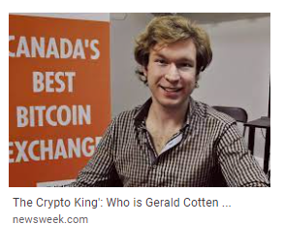
Security violation Examples?

Slide 6
Forms of security?
Data security
Programming security
Network security
OS security
Database security

Slide 7
Syllabus

Slide 8
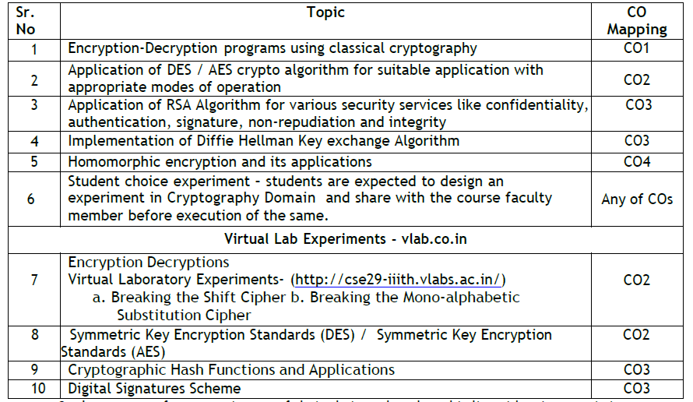
Lab work

Slide 9
Internal assessments
IA 1
Protocol Design for secure data transmission
Group assignment
Peer grading
IA2
Study of research/ Technical paper on Security Domain: (Mutual Selection) and report submission
Group assignment
Peer grading

Slide 10
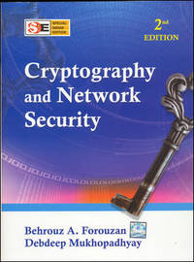
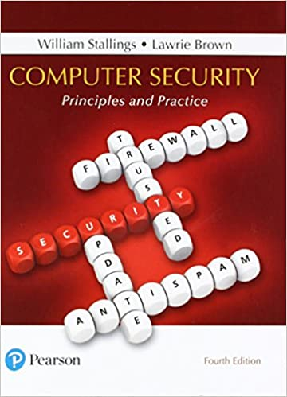
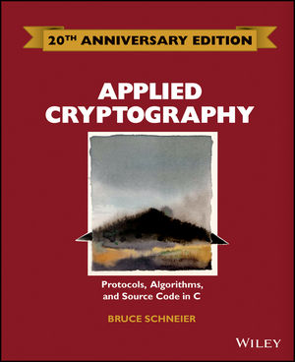
Books

Slide 11
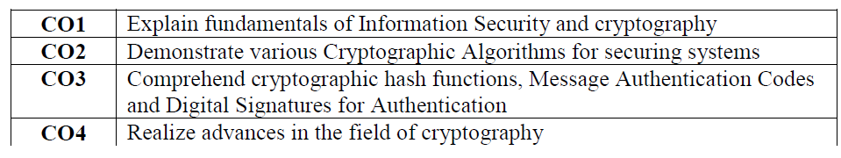
Course Outcomes

Slide 12
Questions?

